Slide 1

HIDDEN MARKOV MODEL (HMM)
- Statistical model for text processing

Slide 2
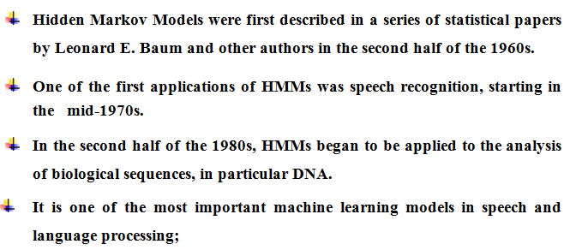
HIDDEN MARKOV MODEL (HMM)

Slide 3
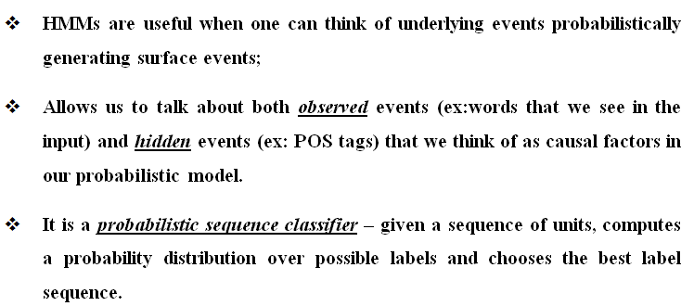
HIDDEN MARKOV MODEL (HMM)

Slide 4
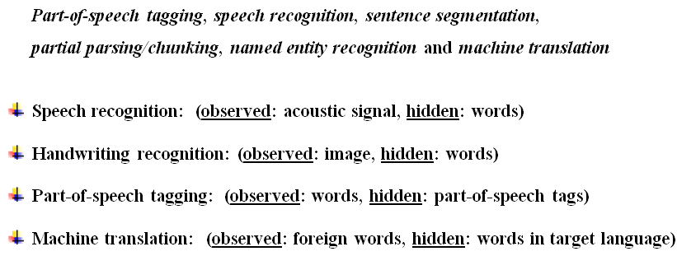
APPLICATIONS

Slide 5
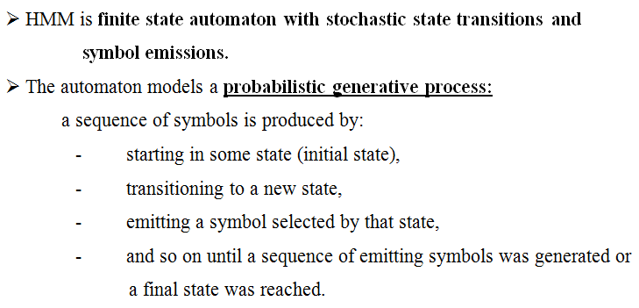
HMM - FORMAL DEFINITION

Slide 6
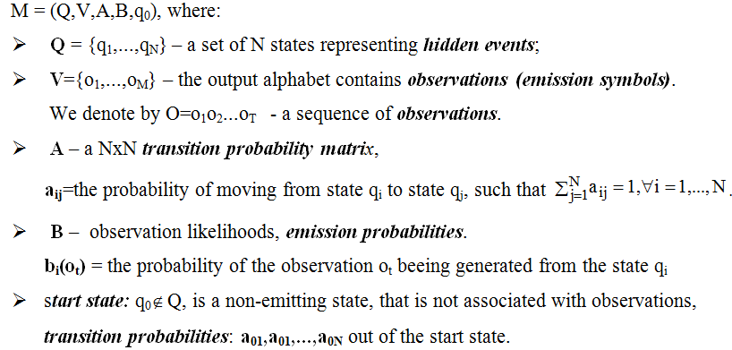
HMM - FORMAL DEFINITION

Slide 7
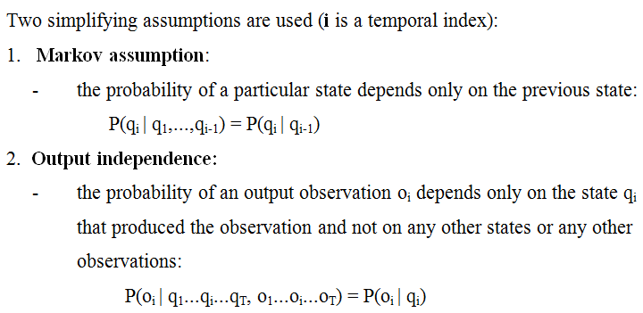
HMM- ASSUMPTIONS

Slide 8
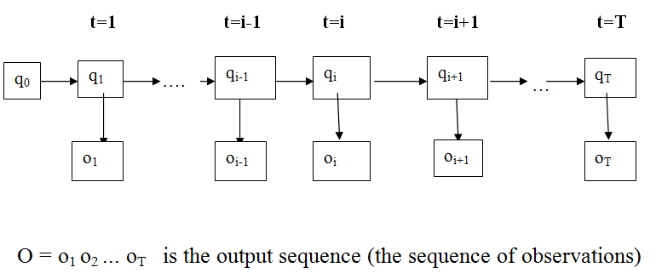
TEMPORAL EVOLUTION OF AN HMM

Slide 9
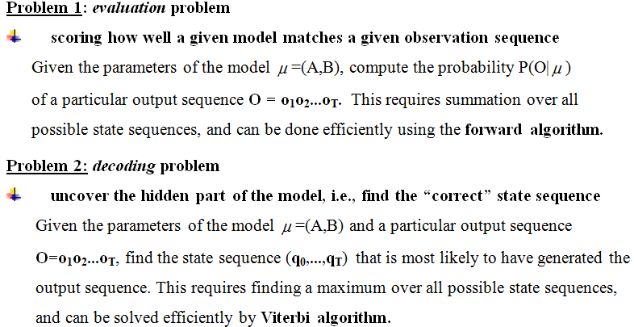
HMM – CANONICAL PROBLEMS

Slide 10
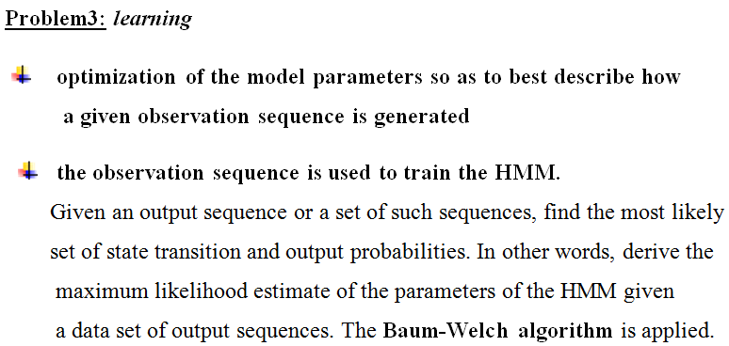
HMM – CANONICAL PROBLEMS

Slide 11
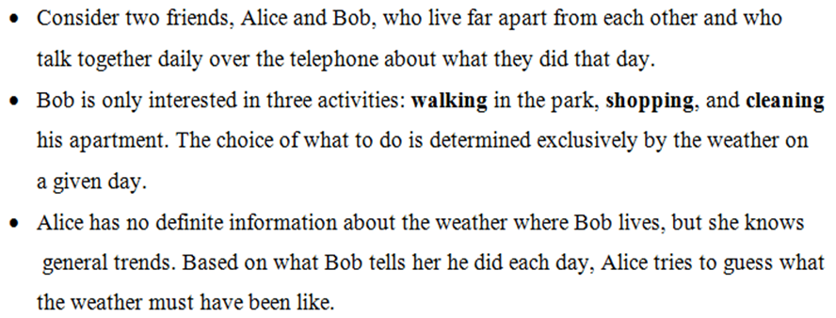
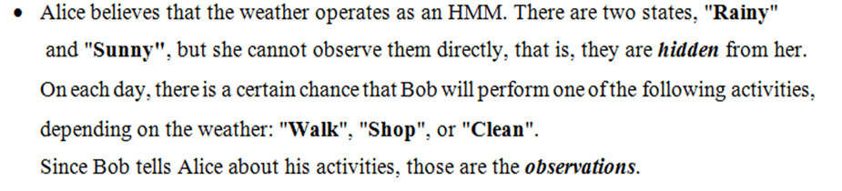
WEATHER PROBLEM

Slide 12
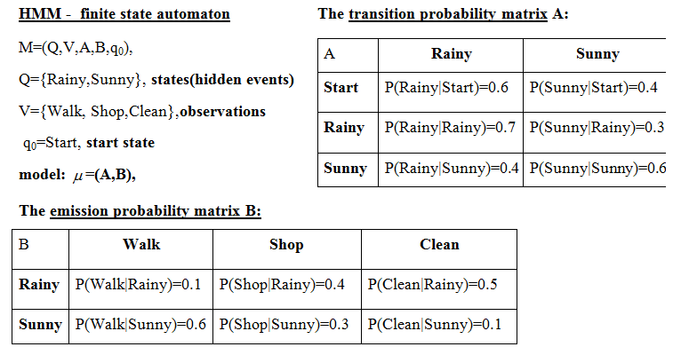
WEATHER OPERATES AS HMM

Slide 13
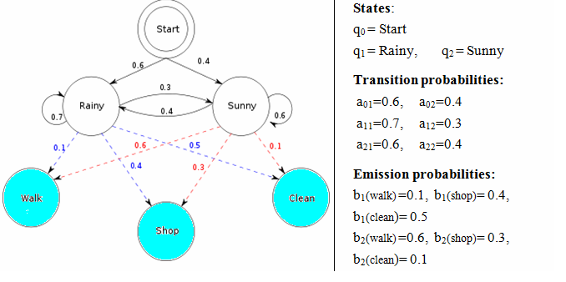
WEATHER OPERATES AS HMM

Slide 14
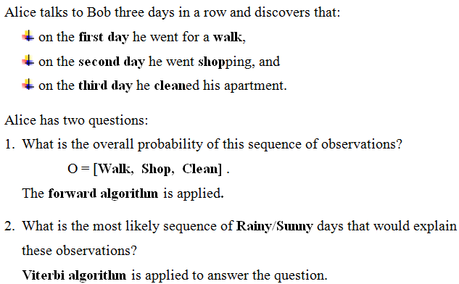
WEATHER PROBLEM

Slide 15
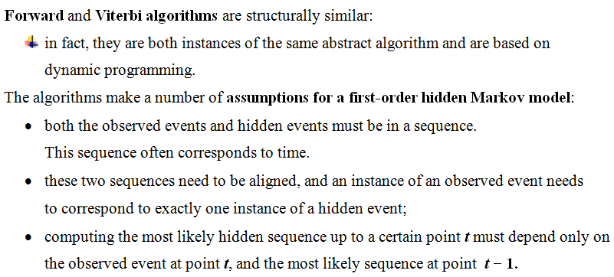

Slide 16
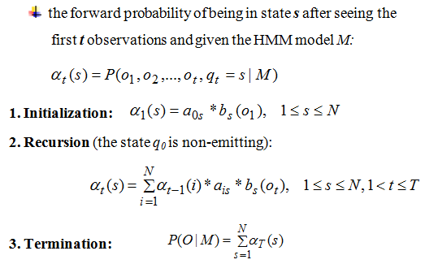
FORWARD PROBABILITIES

Slide 17
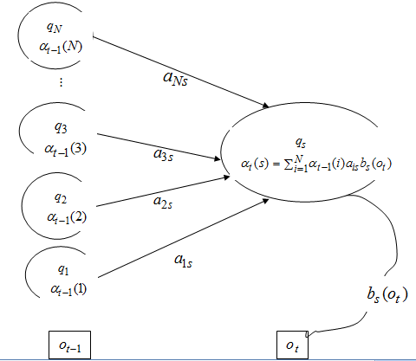
THE TRELLIS FOR COMPUTING

Slide 18
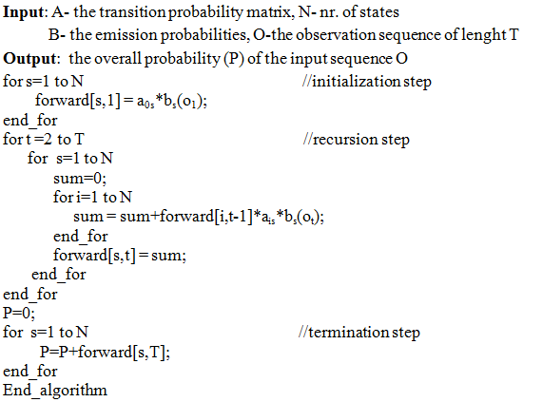
FORWARD ALGORITHM

Slide 19
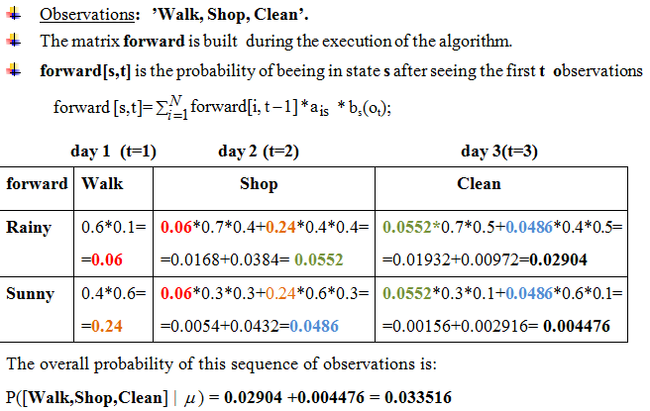
FORWARD ALGORITHM - CALCULATES THE OVERALL
PROBABILITY OF A SEQUENCE OF OBSERVATIONS

Slide 20
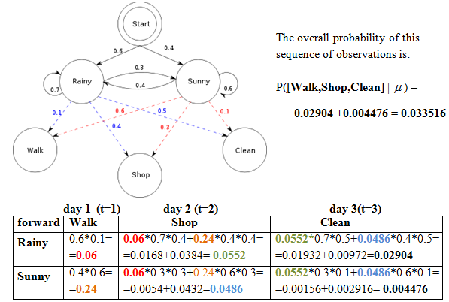


Slide 21
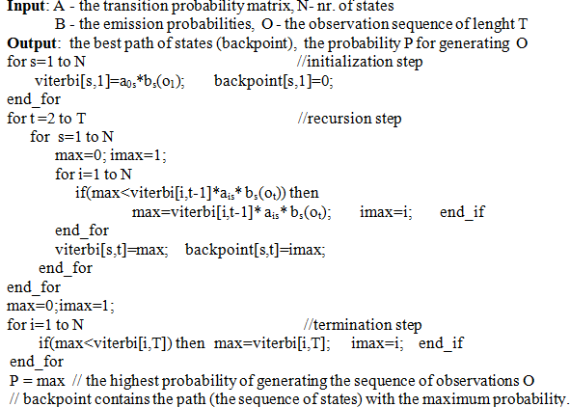
VITERBI ALGORITHM

Slide 22
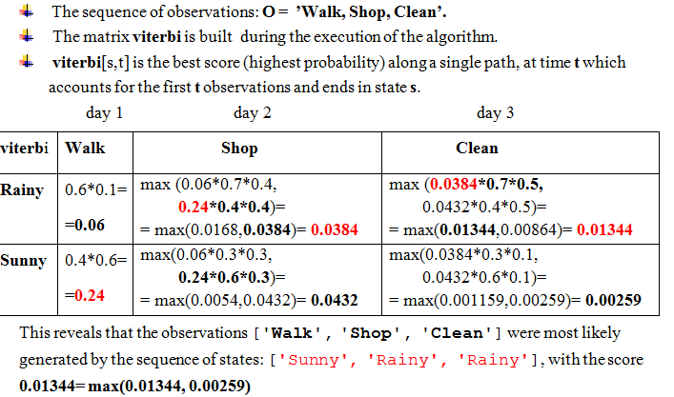
VITERBI ALGORITHM -EXECUTION

Slide 23
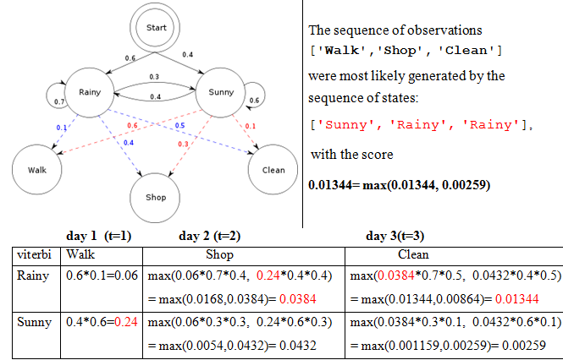

Slide 24
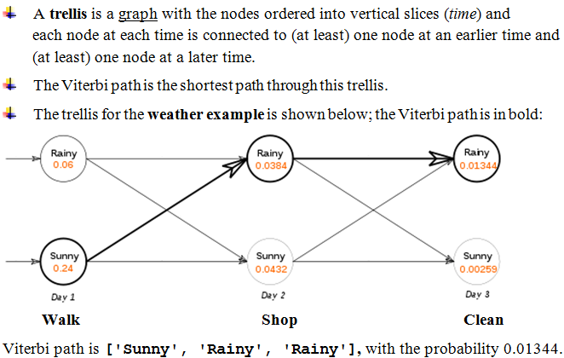
VITERBI’S ALGORITHM---THE TRELLIS DIAGRAM

Slide 25
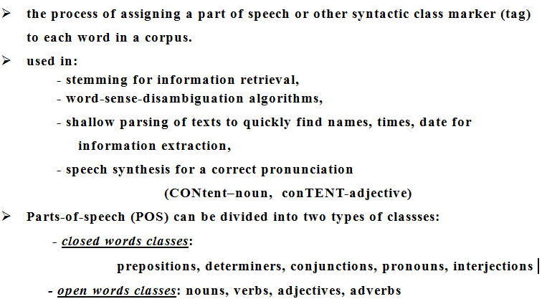
PART-OF-SPEECH TAGGING

Slide 26
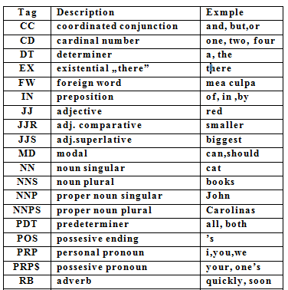
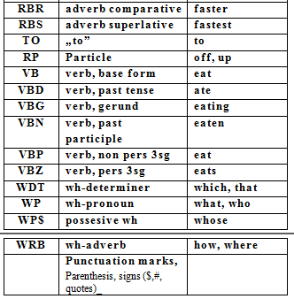

Slide 27
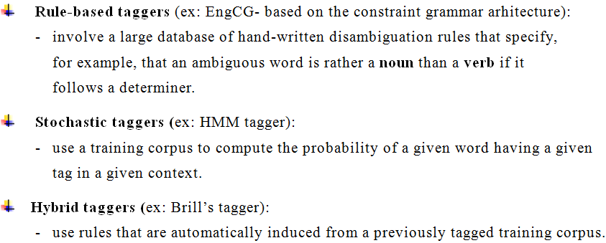
TYPES OF POS-TAGGERS

Slide 28
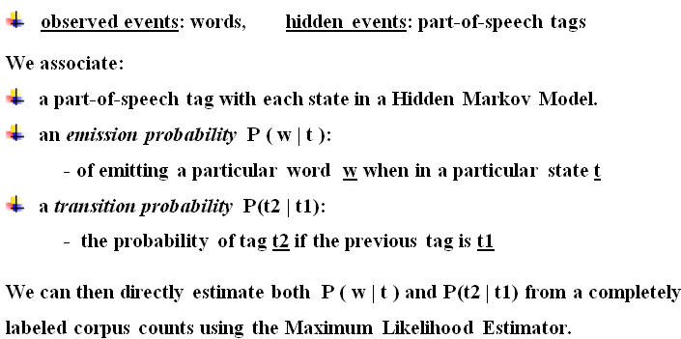
HMM FOR POS TAGGING

Slide 29
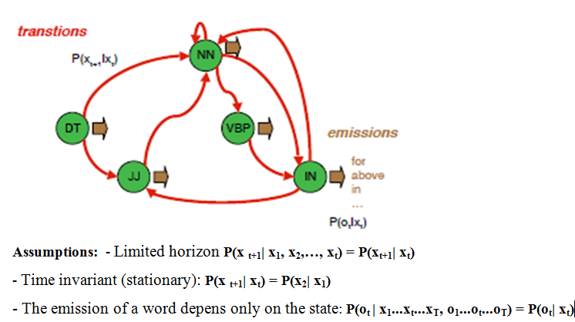

Slide 30
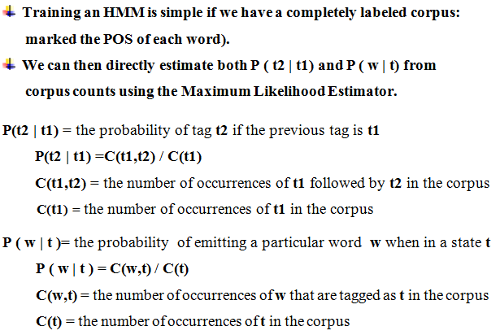
TRAINING AN HMM FOR POS TAGGING

Slide 31
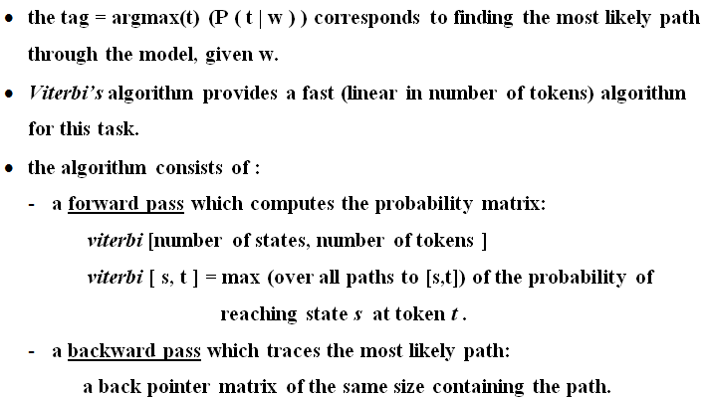
POS TAGGING- DECODING HMM

Slide 32
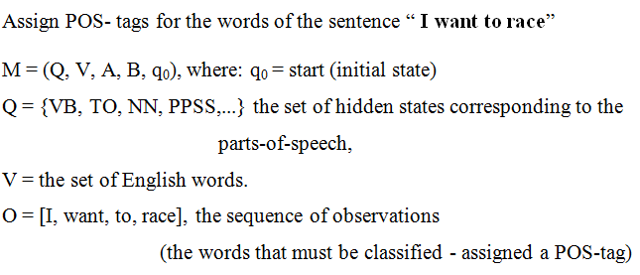
EXAMPLE: HMM USED FOR POS TAGGING

Slide 33
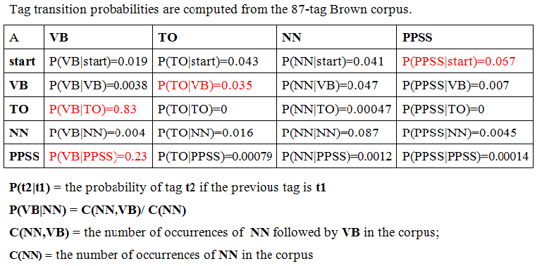
THE TRANSITION PROBABILITY MATRIX

Slide 34
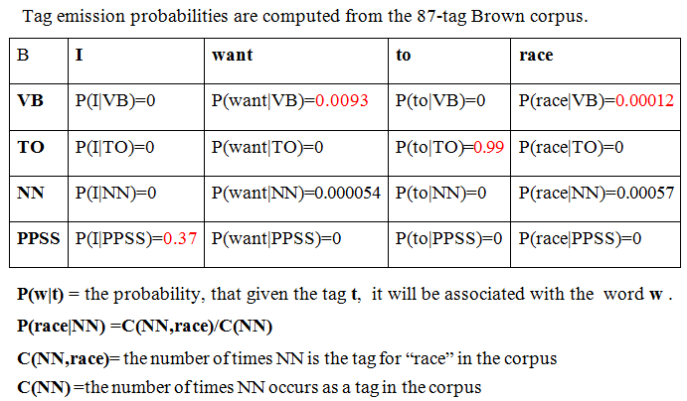
THE EMISSION PROBABILITY MATRIX

Slide 35
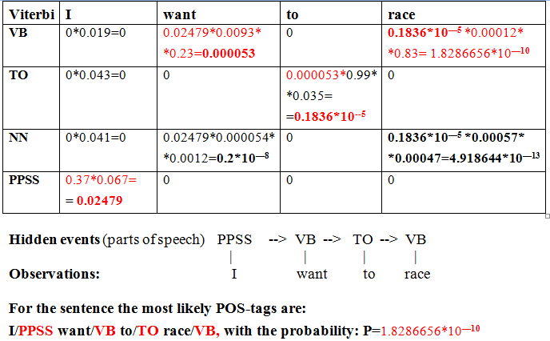
VITERBI’S ALGORITHM

Slide 36
